Slide 1
Presented By: 1.Shubham Chavan Guide: Shreyas Jadhav Sir 2.Mayuri Vispute 3.Aditya Joshi 4.Manisha Mahajan PG-DMC Sunbeam Institute of Information Technology, Pune.
Indian HERITAGE Hub

Slide 2
OUTLINE
1.Introduction.
2.Flow control diagram.
3.Motivation.
4.Limitation and Future Scope In Existing System
4.Tools and Technology To Be Used.
5.Use case Diagram. 6.ER Diagram.
7.Conclusion .

Slide 3
Introduction
Welcome to the Indian Heritage Hub – a dynamic platform built to celebrate, share, and preserve the rich heritage of Indian culture. Our project revolves around two key features that aim to bring cultural knowledge
and it’s relations to with the Science to every user’s fingertips:
Cultural Calendar: Stay connected with India’s diverse traditions through daily notifications and event updates.
Articles & Authors Platform: Authors can publish cultural Articles, and users can explore them seamlessly.
.
The platform supports three main roles:
Admin: Manage all platform activities, ensuring a smooth and secure experience for everyone.
Author: Upload articles, interact with readers, and share cultural content.
User: Explore Articles, cultural calendar, images, videos, quiz.

Slide 4
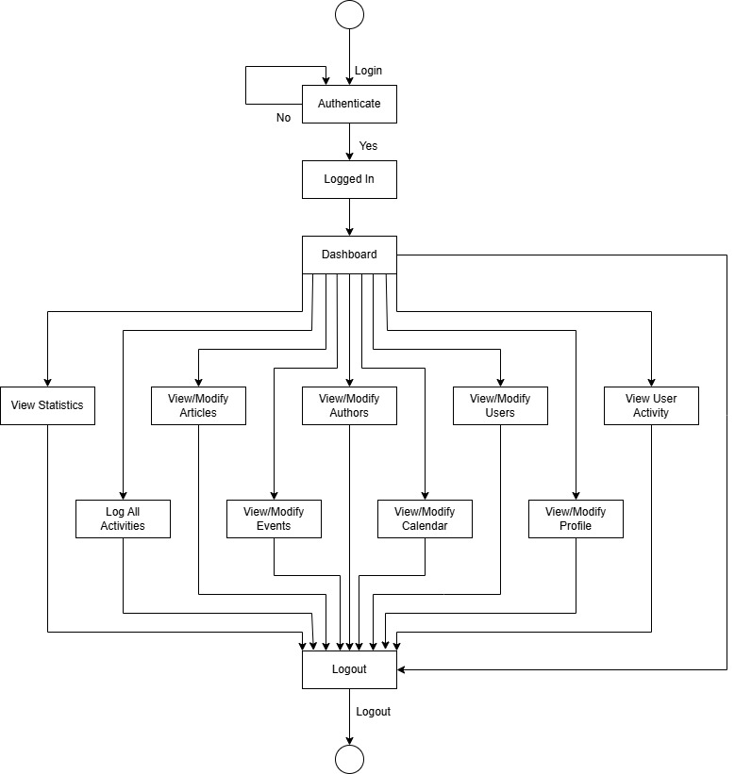
Flow Control Diagram
Admin Flow Control :

Slide 5
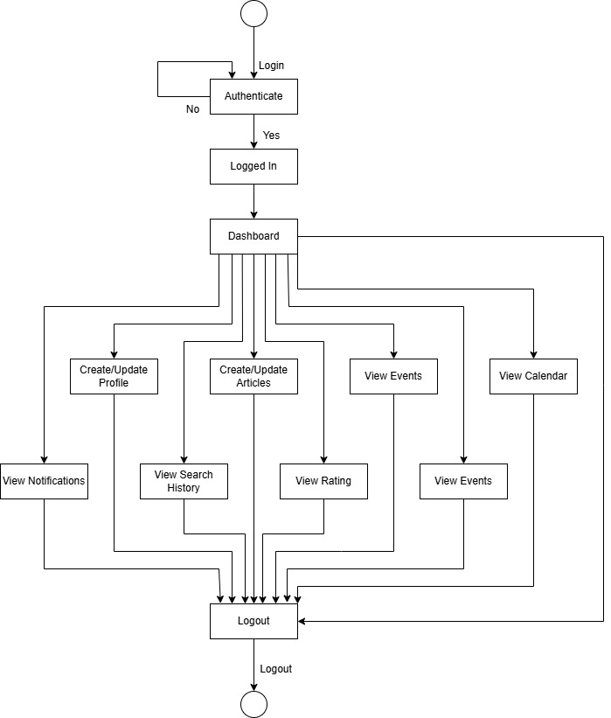
Flow Control Diagram
Author flow Control :

Slide 6
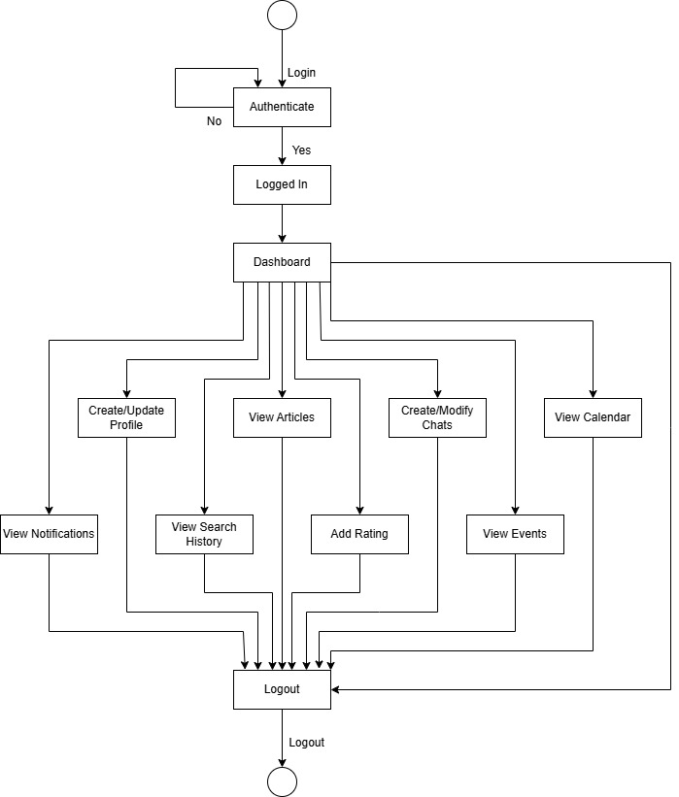
Flow Control Diagram
User Flow Control :

Slide 7
Motivation
Preserving Indian Culture:
Objective: To create a digital space dedicated to preserving and promoting India's rich cultural heritage.
Why: India has a vast and diverse cultural history that needs to be passed down to future generations in an accessible format.
Promoting Cultural Awareness:
Objective: To increase awareness about India’s traditional art forms, festivals, languages, and historical significance.
Why: With globalization and rapid modernization, younger generations may lose connection with their cultural roots. This project bridges that gap.
Connecting Indian Culture with Science
Many Indian cultural practices are based on scientific reasons (like yoga, Ayurveda, temple architecture, etc.)
We want to show how our traditions are not just beliefs—they are also backed by science. This will help people understand the logic behind our culture and respect it more

Slide 8
Limitation & Future scope in Existing System
Limited Content Volume Initially:
Limitation: The platform will start with a limited amount of content (articles, books, and media).
Reason: As the platform is in its early stages, it may take time to gather substantial content from authors, artists, and contributors
Geographical and Language Barriers:
Limitation: The content will initially be available primarily in English and a few regional languages.
Reason: With India’s linguistic diversity, reaching all linguistic communities requires more time, translation resources, and regional contributions.
Dependency on User-Generated Content:
Limitation: The success of the platform is heavily dependent on contributions from authors, artists, and users.
Reason: Without active participation from content creators, the platform’s resources may remain limited.

Slide 9
Tools And Technology
Hardware Technology:
Processor:
Minimum Intel Core i3 (or equivalent).
Justification: Sets the baseline performance for running backend servers and frontend interfaces smoothly
RAM:
Minimum 4 GB.
Justification: Enough to handle multiple browser tabs, code editors, and lightweight development processes.
Storage:
256 GB SSD preferred (or) 500 GB HDD minimum.
Justification: Faster system booting, quicker application loading, and smoother handling of databases and development environments

Slide 10
Tools And Technology
Operating System:
Windows 10 or 11
Software Technology:
Frontend Framework:
React.js (for building user interfaces)
Android.
Backend Technologies:
Java (programming language)
Spring Boot Framework (for backend development)
Database:
MySQL (for data storage and management)

Slide 11
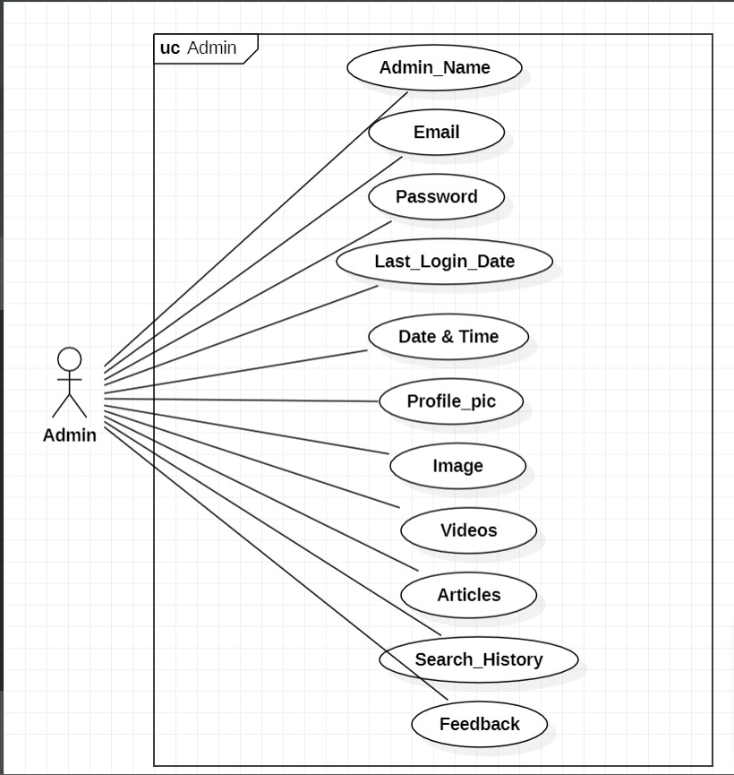
Use Case Diagram
Use Case Diagram(Admin):

Slide 12
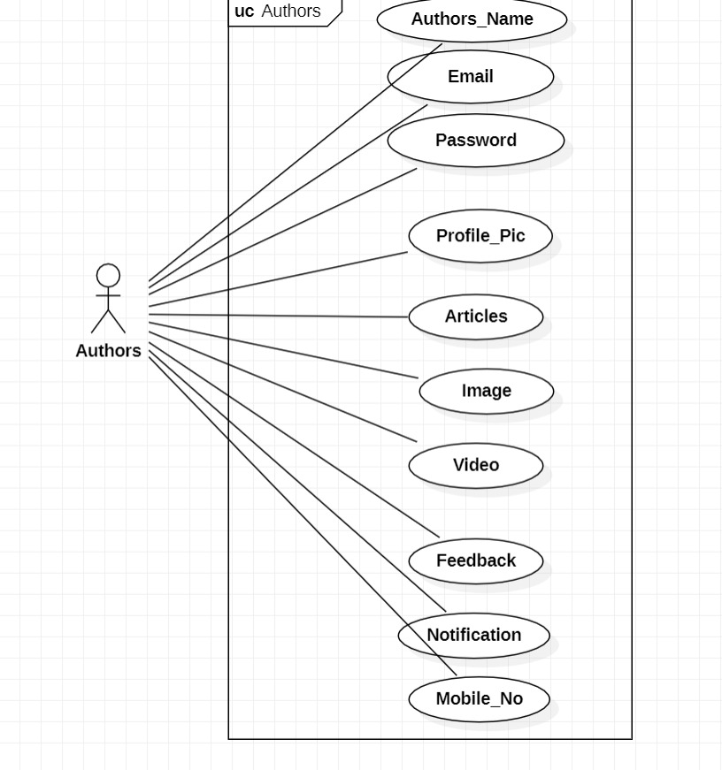
Use Case Diagram
Use Case Diagram(Author) :

Slide 13
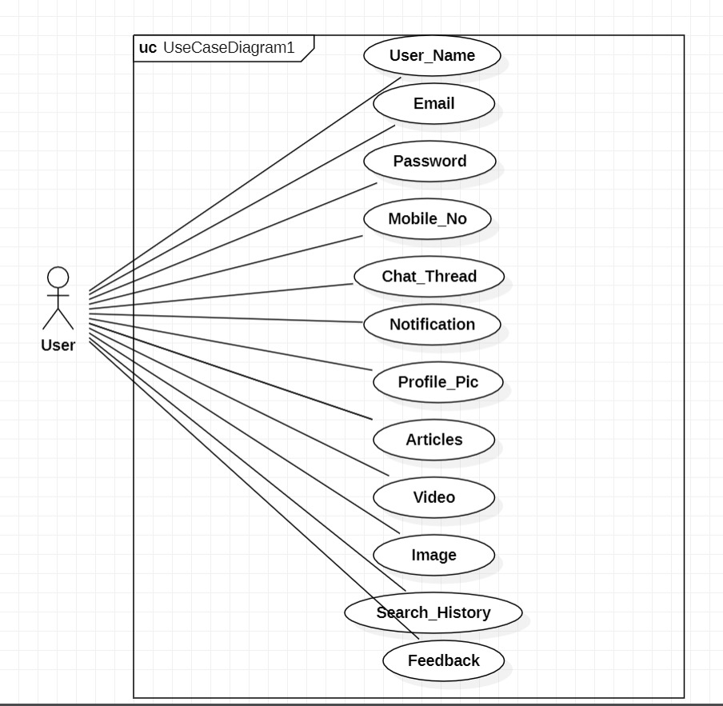
Use Case Diagram
Use Case Diagram(User):

Slide 14
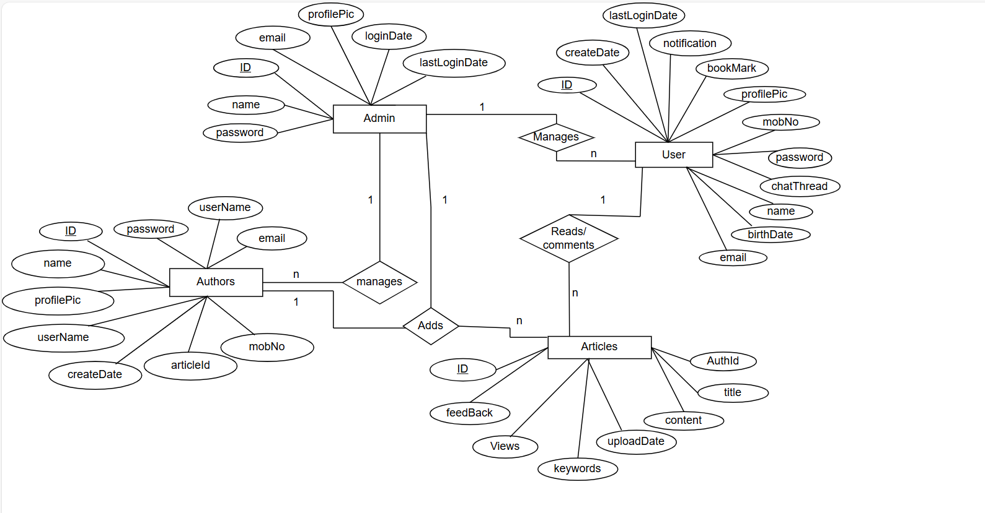
ER Diagram

Slide 15
Conclusion
The Indian Heritage HUB is a dedicated platform to preserve, promote, and celebrate the rich cultural legacy of India.
It provides an accessible space for users to explore cultural calendars, read and upload heritage-related content, and engage with a vibrant cultural community
By integrating modern technologies like React.js, Java Spring Boot, and MySQL, the platform ensures a responsive, scalable, and user-friendly experience
Despite initial limitations such as content volume and multilingual support, the project lays a strong foundation for future expansion into offline access, VR/AR experiences, and global outreach
The project serves as a meaningful step towards bridging the gap between tradition and technology, fostering cultural awareness among the youth and global audiences
In future, collaboration with educational institutions and integration of interactive learning tools will further enhance the platform’s impact and reach.

